Slide 1
Online Marketing 2017 - 2018
Tinka Overzier
Dick Heinhuis

Slide 2
The assignments
Online Marketing
- Presentation assignments and chapters (team)
- Presentation analysis website case study (individual)
- Presentation progress case study (individual)
- Paper (individual, week 20)

Slide 3
Presentations, teams and assignments

Slide 4
Week | Presentation | Preparation next week
1 | Introduction marketing | Presentation consumer profile (team)
2 | Group presentation consumer profile (choose country) History of eBusiness | Presentation top 10 companies turnover (team)
3 | Group presentation presentation top 10 companies turnover per country Products/services perspective | Presentation top 10 visitors (team)
4 | Group presentation top 10 companies visitors per country/Worldwide Consumer perspective | Presentation chapter 2 (team) Presentation analysis website (individual)
5 | Group presentation chapter 2 Individual presentations websites | Presentation analysis website (individual)
6 | Individual presentations websites Industry perspective | Presentation chapter 4 (team) Presentation analysis website (individual)
7 | Individual presentations websites Group presentation chapter 4

Slide 5
11 | Individual presentations websites Marketing segementation | Presentation analysis website (individual)
12 | Individual presentations website Marketing instruments | Presentation analysis website (individual) Presentation chapter 5 (team)
13 | Group presentation chapter 5 Individual presentations | Presentation chapter 7 and 8 (team) Presentation analysis website (individual)
14 | Group presentation chapter 7 and 8 Individual presentations
15 | Wrap up
16 - 19 | Write paper
20 | Deliver paper

Slide 6
Grading Online Marketing
Paper case study: 60%
Presentation individual website: 10%
Presentation chapter: 15%
Presentation assignment: 15%

Slide 7
Case study Online Marketing
Choose an organization (within the industry)
Apply the theories of the course on this organization
See the toetsmatrijs for the content

Slide 8
Who is who
Introduction participants
Teams and assignments
8 teams of 4 students

Slide 9
Week 1
Choose your team
Choose your (individual) company
Marketing: the theory

Slide 10
What is marketing
A way of thinking
A way of organizing
A way of acting
A way of describing

Slide 11

This is not

Slide 12
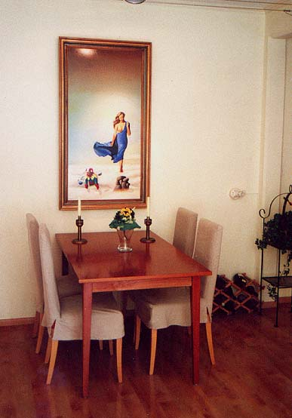
But

Slide 13
Typology organisation
+
(strategically integrated) (marketing worriors)
ORIENTATION
COMPETITOR
-
(customer preoccupied (strategically inept)
+
-
ORIENTATION CUSTOMER

Slide 14
Marketing concept
CLASSIC (TILL 1980)
STRATEGIC (1980-1990)
RELATIONS (1990 – 2000)
VALUE (2000 - )
CUSTOMERS
COMPETITORS
DIRECT RELATIONS
CUSTOMER VALUE
THE BRAND

Slide 15
Period |  | Focus
- 1980 | Classic | Customer
- 1990 | Strategic | Competitor
- 2000 | Relations | Customer value
- now | Mission/values | The brand

Slide 16
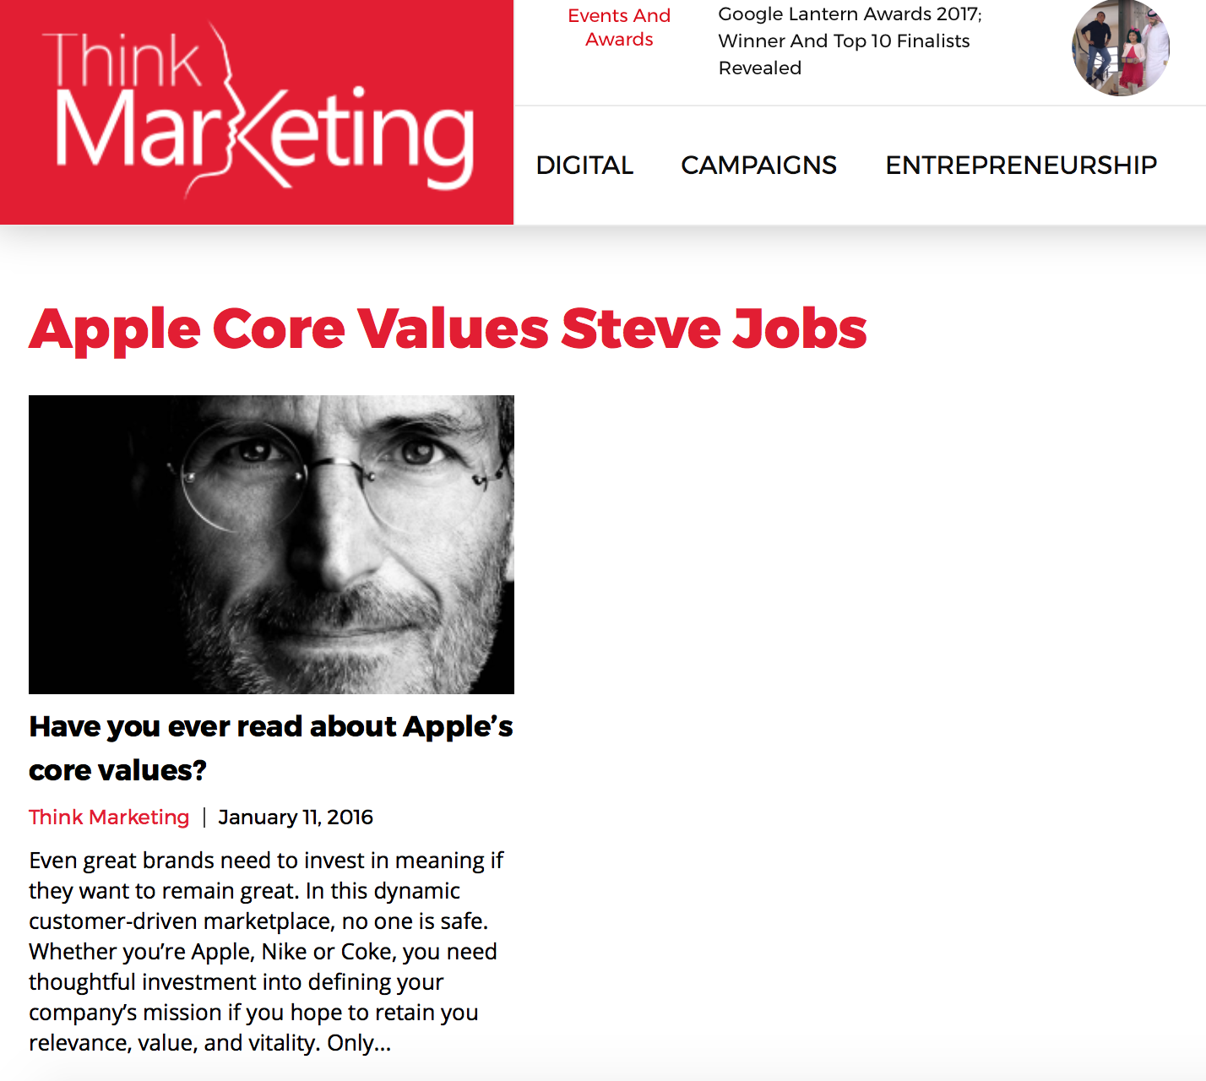


Slide 17
Week 2
Presentations: who is the customer in ????
eBusiness and Online marketing
The history of eBusiness

Slide 18
Week | Presentation | Preparation next week
1 | Introduction marketing | Presentation consumer profile (team)
2 | Group presentation consumer profile (choose country) History of eBusiness | Presentation top 10 companies turnover (team)
3 | Group presentation presentation top 10 companies turnover per country Products/services perspective | Presentation top 10 visitors (team)
4 | Group presentation top 10 companies visitors per country/Worldwide Consumer perspective | Presentation chapter 2 (team) Presentation analysis website (individual)
5 | Group presentation chapter 2 Individual presentations websites | Presentation analysis website (individual)
6 | Individual presentations websites Industry perspective | Presentation chapter 4 (team) Presentation analysis website (individual)
7 | Individual presentations websites Group presentation chapter 4

Slide 19
What is Online marketing?

Slide 21
E-Business: the perspectives
Financial perspective (4)
Technology perspective
(2)
Industry perspective (3)
E-Business
Consumer perspective (1)

Slide 22
Perspectives
Financial
Industry
Business model (how to
earn money)
Strategy, competitors,
industry structure (how to
beat the competitors)

Slide 23
Perspectives
Technology
Consumer
Technology acceptance
models (when, why do
consumers use IT systems)
Consumer behaviour,
product/service characteristics
(who uses why the Internet for
what)

Slide 24
The context of e-Business
Economic developments
The new economy
The information economy

Slide 25
Economic developments
Industrial revolution (1750 – 1880)
Production revolution (1880 – 1945)
Management revolution (1945 - ?)

Slide 26
Economic developments
Labour dominant (till 1800)
Capital dominant (till 1950)
Knowledge dominant (till ?)

Slide 27
The market
Global markets (from 1950)
Multinationals in stead of regions (from 1970)
Information/network society

Slide 28
Consequences
From social capitalism to new capitalism
Richard Sennett
Robert Putnam

Slide 29
Characteristics
Flexibility (instead of predictable)
Potential skills (instead of a predictable life)
Prove yourself constantly (without garantuee)

Slide 30
Consequences
Decrease reliability
Decrease responsibility
Decrease working ethos
Consumption society

Slide 31
Consequences for companies
Need for decentralized information
Disappearance of middle management
Flexibility: the casino economy
The shamrock organisation

Slide 32
The development of companies
Production oriented (till 1950)
Sales oriented (till 1970)
Marketing oriented (from 1960s)
Client oriented (from 1990s)

Slide 33
Developments in ICT
Technical changes (1950)
Managerial control (1960-1970)
Institutional core activities (1980-1990)
The network revolution
Source: Laudan, Laudan, Management Information Systems, 2000

Slide 34
The new economy
The network is the enterprise
Increase of productivity by the use of ICT
Internet, e-Business, e-Commerce

Slide 35
Week 3
Presentations top 10 turnover companies
The marketing perspective (based on academic research)

Slide 36
Week | Presentation | Preparation next week
1 | Introduction marketing | Presentation consumer profile (team)
2 | Group presentation consumer profile (choose country) History of eBusiness | Presentation top 10 companies turnover (team)
3 | Group presentation presentation top 10 companies turnover per country Products/services perspective | Presentation top 10 visitors (team)
4 | Group presentation top 10 companies visitors per country/Worldwide Consumer perspective | Presentation chapter 2 (team) Presentation analysis website (individual)
5 | Group presentation chapter 2 Individual presentations websites | Presentation analysis website (individual)
6 | Individual presentations websites Industry perspective | Presentation chapter 4 (team) Presentation analysis website (individual)
7 | Individual presentations websites Group presentation chapter 4

Slide 37
Online marketing: the perspectives
Financial perspective (4)
Technology perspective
(2)
Industry perspective (3)
On line marketing
Consumer perspective (1)

Slide 38
Test the audience
Make a list of the products/services for which you used the mobile Internet to search for information during the last month
Which of these products/services did you buy and where (Internet, shop, catalog)
Make a list of the products/services your parents bought the last month through the mobile Internet
Make a list of the products/services your grandparents bought last month through the mobile Internet
Make a list of the products/services you think your fellow students bought last month through the mobile Internet

Slide 39
I. Marketing perspective
I.1 Nature of product/service
I.2 Stages of the decision making process
I.3 Consumer characteristics

Slide 40
Test the audience
In groups of 3/4 students: which products/services are suitable to sell through the mobile Internet and why?

Slide 41
1.1 Nature of services/products
PRODUCTS
Physical
Standardization
Production separate
Possible to store
SERVICES
Intangible
Heterogenity
Simultaneous production
Perishability
Koiso-Kantilla (2004)

Slide 42
Classification according to tasks
Perceived risk
Frequency of purchase
Functional versus expressive value
Zeng and Reinartz (2003)

Slide 43
Evaluation stage
High touch versus low touch
High information content versus low information content
Demand on consumer expertise

Slide 44
The information component
Search goods
Experience goods 1
Experience goods 2
Credence goods
Girard et al. (2003)

Slide 45
Information and tangibility
 | Experience goods | Search goods
Low tangibility | E.g. Advisory services | E.g. Stock market quotes
High tangibility | E.g. Personal items | E.g. Music CD’s
Poon (1999)

Slide 46
Positive and negative reinforcement products
 | % who have shopped online | % who have purchased online | Purchase/shop ratio
Travel services | 69% | 44 % | 63 %
CD/Music | 53% | 35% | 66%
Wine | 16% | 4% | 25%
Sporting goods | 41% | 21% | 51%
Virus detection software | 17% | 9% | 49%
Insurance | 13% | 1% | 8%
Tires | 9% | 2% | 23%
Perotti et al. (2003)

Slide 47
Which products/services

Slide 48
Service process matrix
High
Interaction
and customization
Low
Low High
Labor intensity
Service shop | Professional service
Service factory | Mass service
Junglas and Watson, 2004

Slide 49
Internet service process matrix
High
Customization
Low
Low High
Interaction
Service center | The club
Utility | Mass entertainment
Junglas and Watson, 2004

Slide 50
Conclusions?
Books
Travel
Tickets
Pornography
(Not the shopping goods, which were predicted in 1967 by Doody and Davidson, HBR, )

Slide 51
Week 4
Presentations top 10 websites visitors
Consumer perspective

Slide 52
Week | Presentation | Preparation next week
1 | Introduction marketing | Presentation consumer profile (team)
2 | Group presentation consumer profile (choose country) History of eBusiness | Presentation top 10 companies turnover (team)
3 | Group presentation presentation top 10 companies turnover per country Products/services perspective | Presentation top 10 visitors (team)
4 | Group presentation top 10 companies visitors per country/Worldwide Consumer perspective | Presentation chapter 2 (team) Presentation analysis website (individual)
5 | Group presentation chapter 2 Individual presentations websites | Presentation analysis website (individual)
6 | Individual presentations websites Industry perspective | Presentation chapter 4 (team) Presentation analysis website (individual)
7 | Individual presentations websites Group presentation chapter 4

Slide 53
E-Business: the perspectives
Financial perspective (4)
Technology perspective
(2)
Industry perspective (3)
E-Business
Consumer perspective (1)

Slide 54
Marketing perspective (I.2)
The stages of decision making

Slide 55
Test the audience
Assume you are intending to buy a new TV. How do you come to your decide which television you are going to buy?
Assume you are intending to buy a new laptop. How do you come to your decide which laptop you are going to buy?

Slide 56
Stages of decision making
Problem recognition
Information search
Evaluation of alternatives
Purchase decision
Post purchase behavior
Howard and Sheth (1969), Engel et al. (1994), Kotler (2003)

Slide 57
Information search paradox
Number of
important features
Product familiarity

Slide 58
Stages and channel preferences
 | Pro off-line | Pro on-line
Problem recognition | No arguments | No arguments
Information search |  | Reduction of the search effort for price and product information
Evaluation | Feel and touch; perceived risk | Only price and other specific attributes
Purchase | Delivery time Perceived risk | Digitized products/services (delivery time)
Gupta et al. (2004)

Slide 59
Doffer et al. (2005)

Slide 60
Doffer et al. (2005)

Slide 61
Marketing perspective (1.3)
Consumer characteristics

Slide 62
CBS (2010)

Slide 63
% of the age group

Slide 64
CBS (2010)

Slide 65
CBS (2010)

Slide 66
Reasons
The higher educated, the higher the efficiency (less time, therefore lower transaction costs)
The higher the experience (age, education, gender) the higher the efficiency (lower prices)

Slide 67
Week 5
Presentations, presentations

Slide 68
Week | Presentation | Preparation next week
1 | Introduction marketing | Presentation consumer profile (team)
2 | Group presentation consumer profile (choose country) History of eBusiness | Presentation top 10 companies turnover (team)
3 | Group presentation presentation top 10 companies turnover per country Products/services perspective | Presentation top 10 visitors (team)
4 | Group presentation top 10 companies visitors per country/Worldwide Consumer perspective | Presentation chapter 2 (team) Presentation analysis website (individual)
5 | Group presentation chapter 2 Individual presentations websites | Presentation analysis website (individual)
6 | Individual presentations websites Industry perspective | Presentation chapter 4 (team) Presentation analysis website (individual)
7 | Individual presentations websites Group presentation chapter 4

Slide 69
Week 6
Presentations
Industry perspective (link with Strategic Management)

Slide 70
Week | Presentation | Preparation next week
1 | Introduction marketing | Presentation consumer profile (team)
2 | Group presentation consumer profile (choose country) History of eBusiness | Presentation top 10 companies turnover (team)
3 | Group presentation presentation top 10 companies turnover per country Products/services perspective | Presentation top 10 visitors (team)
4 | Group presentation top 10 companies visitors per country/Worldwide Consumer perspective | Presentation chapter 2 (team) Presentation analysis website (individual)
5 | Group presentation chapter 2 Individual presentations websites | Presentation analysis website (individual)
6 | Individual presentations websites Industry perspective | Presentation chapter 4 (team) Presentation analysis website (individual)
7 | Individual presentations websites Group presentation chapter 4

Slide 71
E-Business: the perspectives
Financial perspective (4)
Technology perspective
(2)
Industry perspective (3)
E-Business
Consumer perspective (1)

Slide 72
III. The strategy perspective
III.1 Structure-Conduct-Performance model (Porter, 1980, 1985)
III.2 Resource Based View (Barney, 1991, 1994)
III.3 Multi channel strategy

Slide 73
III.1 The five forces model to define attractiveness of industry (Porter, 1980)

Slide 74
Test the audience
Read Porter’s article
Summarize his conclusions

Slide 75
Test the audience
Are there industry characteristics (based on the five forces model) which explain the use of the Internet as a channel?

Slide 76
Disappearance of barriers of entry
Economies of scale
Product differentiation
Switching costs
Access to distribution channels
(Shin, 2001; Lucas, 2002)

Slide 77
Existing rivalry
Winner takes all
First mover advantage
(Source: Coltman, 2001)

Slide 78
Strategies
Relative
resource
costs
Relative resource-produced value
Lower
Parity
Higher
?
Lower
+
+
Parity
-
0
+
Higher
-
-
?

Slide 79
Strategies to realize competitive advantage (Porter, Treacy and Wiersema)
Cost leadership/operational excellence
Differentiation/product leadership
Focus/customer intimacy

Slide 80
Test the audience
Mention examples of companies that use the Internet to create a competitive advantage

Slide 81
Results
Multi-channel strategy as access-based positioning
Multi-channel strategy as a defense by increasing barriers to entry

Slide 82
III.2 Resource based view (Penrose, 1959, Barney, 1991)
The firm as a bundle of resources
Competitive advantage when resources are:
- Valuable
- Rare
- Costly to imitate
- Organized

Slide 83
Results
e-Technology as a resource
IT-knowledge as resource
Back-end integration as resource
Direct channel experience (economy of scope)
Advantage of scale and scope disappear
Switching costs by multi channel strategy
Focus on brand(s)

Slide 84
Resources
Catalog sellers
Channel conflicts
Disruption in retailing (Christensen and Tedlow, 2000)

Slide 85
Reasons for using the internet
Channel | Price per transaction
Web | $ 1
Call | $ 10
Retail | $ 50
Personal sales | $ 200
Simons et al. (2002)

Slide 86
Dynamic Capabilities

Slide 87
III.3 Strategy perspective
The multi-channel strategy

Slide 88
Advantages internet
Costs reduction
Differentiation
Defensive

Slide 89
Disadvantages internet
Perceived risk (lack of trust)
Delivery and return problems
Impersonal relationship
No psychical inspection

Slide 90
The solution
BRICKS AND CLICKS

Slide 91
Adding the internet
Channel used | Original purchase | Purchases during 24 month period
Catalog only | 76.2 % | 68.8 %
Internet only | 6.5 % | 5.6 %
Store only | 17.3 % | 13.3 %
Multiple channels |  | 12.3 %
Dholakia (2005)

Slide 92
Dholakia et al. (2005)

Slide 93
Results
Multi-channel enhances loyalty, although the results are mixed
Multi-channel customers buy more (?)

Slide 94
Reasons introducing online banking
Source: Bradley and Stewart, 2003

Slide 95
Factors influencing multi-channel strategy in financial industry
Source: Coelho and Easingwood, 2003

Slide 96
The research shopper
Attribute driven decision making
Lack of channel lock-in
Cross channel synergy
Verhoef et al. (2005)

Slide 97
The research shopper
Van Baal and Dach (2005)

Slide 98
E-Business: the perspectives
Financial perspective (4)
Technology perspective
(2)
Industry perspective (3)
E-Business
Consumer perspective (1)

Slide 99
IV: Financial perspective
Electronic Business Models

Slide 100
Content
Definitions
Old & new business models
Business models
Cases
Assignment

Slide 101
Business model
What is a business model

Slide 102
Definition (Timmers, 1999)
An architecture for product, service and information flows, including a description of the various business actors and their roles; and a description of the potential benefits for the various business actors; and a description of the sources of revenue

Slide 103
Business models
Old business models
New business models

Slide 104
Old business models (or strategy)
Operational excellence/cost leadership
Product excellence/differentiation (enhancing the service/product)
Customer intimacy

Slide 105
New business models
E-Shop
E-procurement
E-malls
E-auctions
Virtual communities
Collaboration platforms
Third-party marketplaces
Value chain integrators
Value chain service providers
Information brokerage
Trust and other services

Slide 106
Business models and revenues
E-Shop
E-procurement
E-malls
E-auctions
Virtual communities
Collaboration platforms
Third-party marketplaces
Value chain integrators
Value chain service providers
Information brokerage
Trust and other services

Slide 107
What’s really new about the models
iTunes
eBay
Amazon.com
Google

Slide 108
Week 7
Presentations, presentations

Slide 109
Week | Presentation | Preparation next week
1 | Introduction marketing | Presentation consumer profile (team)
2 | Group presentation consumer profile (choose country) History of eBusiness | Presentation top 10 companies turnover (team)
3 | Group presentation presentation top 10 companies turnover per country Products/services perspective | Presentation top 10 visitors (team)
4 | Group presentation top 10 companies visitors per country/Worldwide Consumer perspective | Presentation chapter 2 (team) Presentation analysis website (individual)
5 | Group presentation chapter 2 Individual presentations websites | Presentation analysis website (individual)
6 | Individual presentations websites Industry perspective | Presentation chapter 4 (team) Presentation analysis website (individual)
7 | Individual presentations websites Group presentation chapter 4

Slide 110
Week 11 – Marketing: Segmentation

Slide 111
11 | Individual presentations websites Marketing segementation | Presentation analysis website (individual)
12 | Individual presentations website Marketing instruments | Presentation analysis website (individual) Presentation chapter 5 (team)
13 | Group presentation chapter 5 Individual presentations | Presentation chapter 7 and 8 (team) Presentation analysis website (individual)
14 | Group presentation chapter 7 and 8 Individual presentations
15 | Wrap up
16 - 19 | Write paper
20 | Deliver paper

Slide 112
The theory

Slide 113
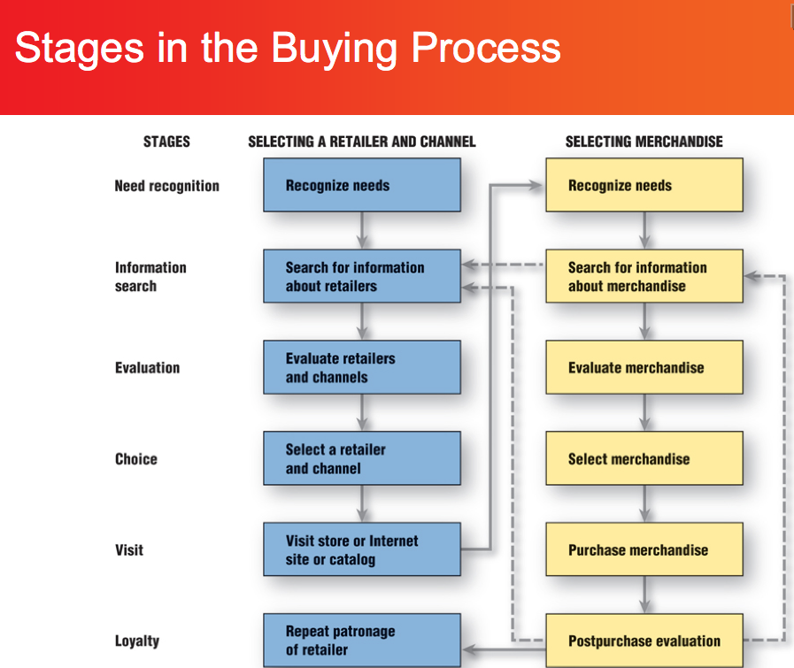
Buying behaviour

Slide 114
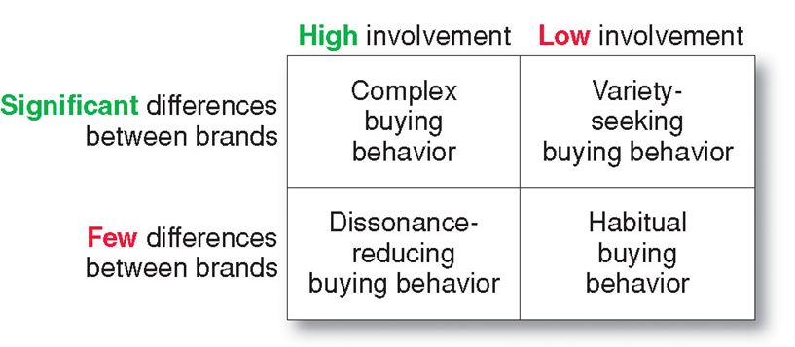
Type of purchase

Slide 115
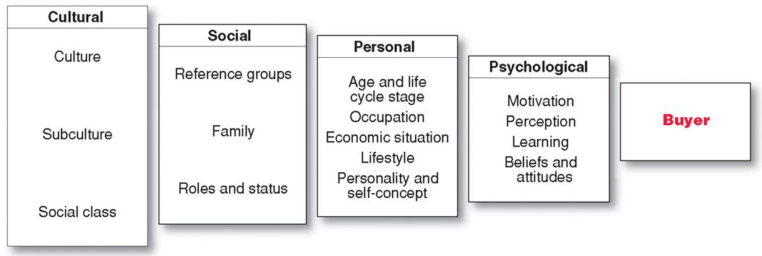

Slide 116
Market segmentation
Reasons
Conditions

Slide 117
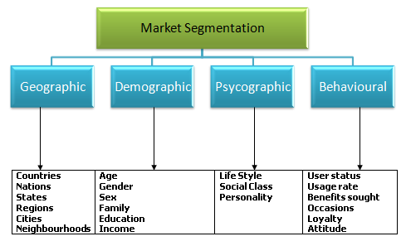

Slide 118
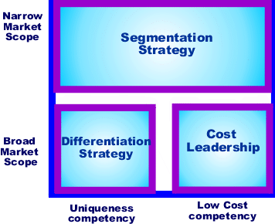

Slide 119
Segmentation and eCommerce
The use of channels

Slide 120

Positioning (CONSISTENCY OF THE 6 P’S)

Slide 121
“Martini that is the right one” commercials

Slide 122
Week 12
Marketing: the marketing instruments
Presentations
Working on the individual assignment

Slide 123
11 | Individual presentations websites Marketing segementation | Presentation analysis website (individual)
12 | Individual presentations website Marketing instruments | Presentation analysis website (individual) Presentation chapter 5 (team)
13 | Group presentation chapter 5 Individual presentations | Presentation chapter 7 and 8 (team) Presentation analysis website (individual)
14 | Group presentation chapter 7 and 8 Individual presentations
15 | Wrap up
16 - 19 | Write paper
20 | Deliver paper

Slide 124
Marketing strategy
Product/Service
Price
Place (distribution)
Promotion (marketing communication)
(Personel)
(Processes)
(Physical evidence)

Slide 125
Product/Service
CORE BENEFIT
FORMAL
AUGMENTED

Slide 126
Price
Customer based
Competitor based
Organization based

Slide 127
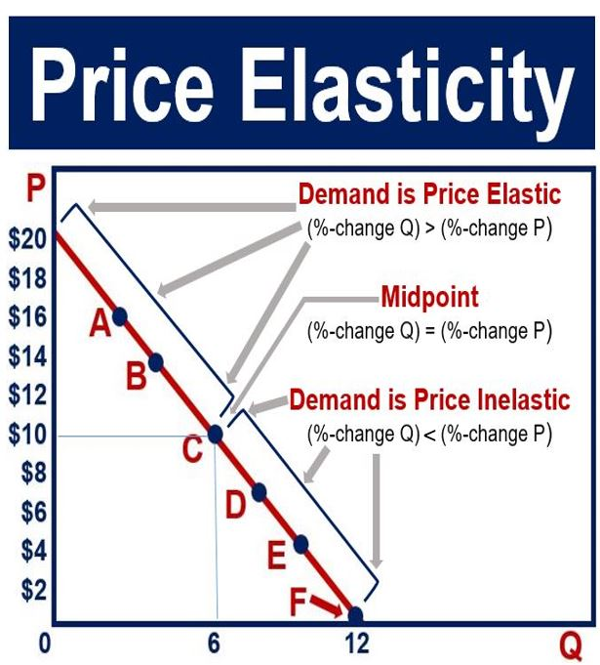
Customer based

Slide 128
Price strategy
Psychological
Demand differentiation
Bundling
Discrimination

Slide 129
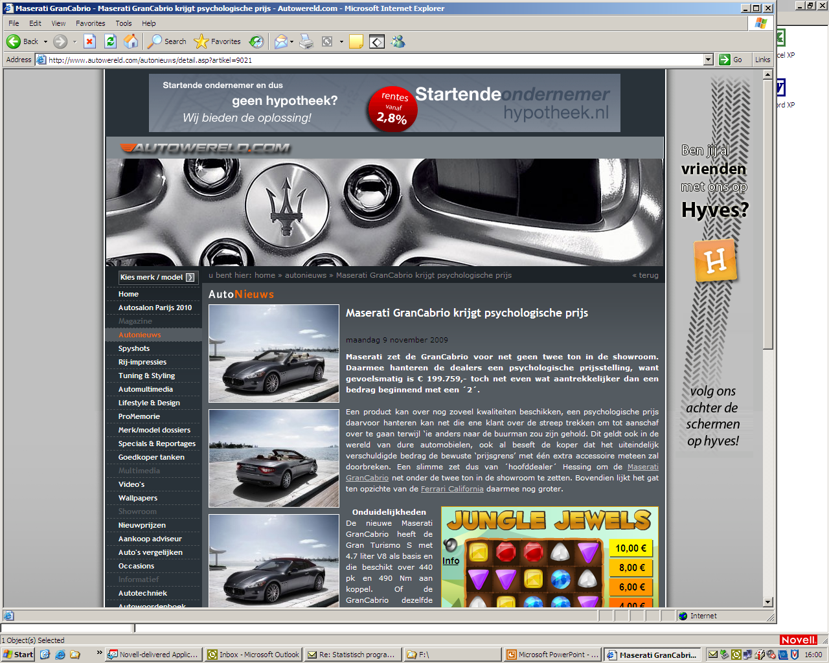

Slide 130
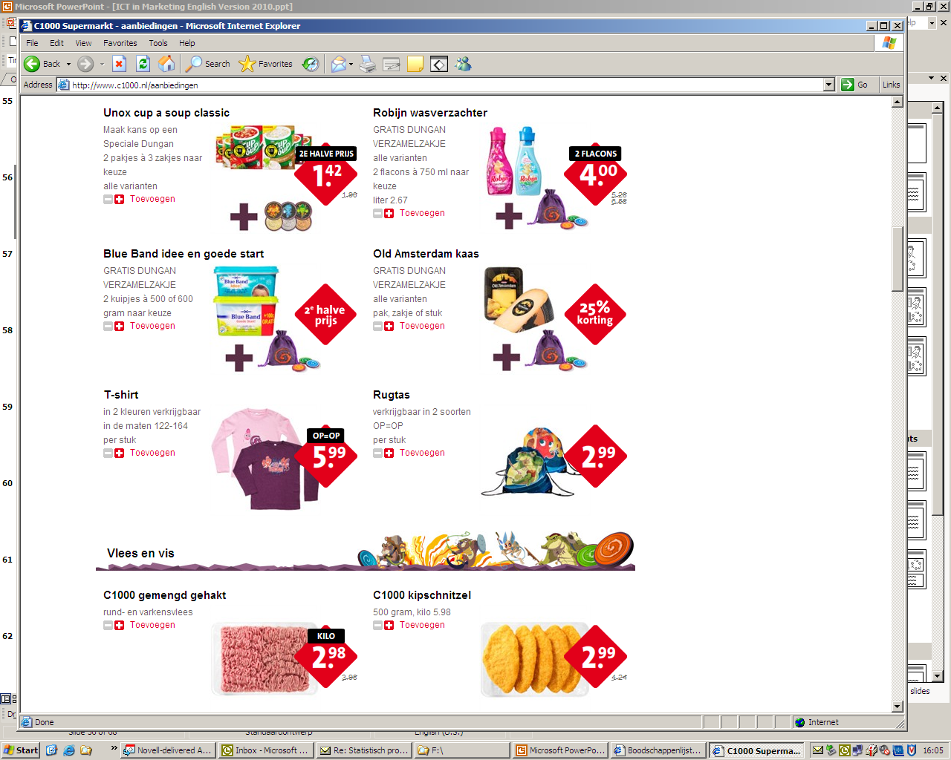

Slide 131
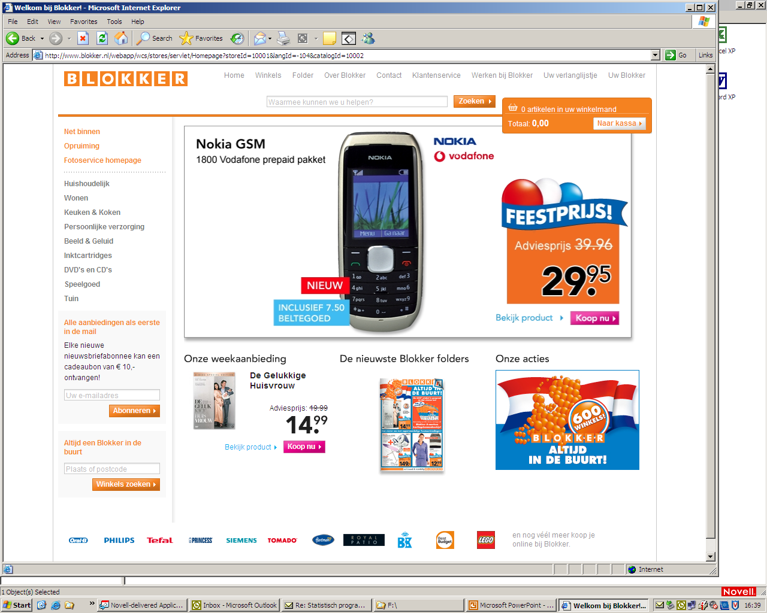

Slide 132
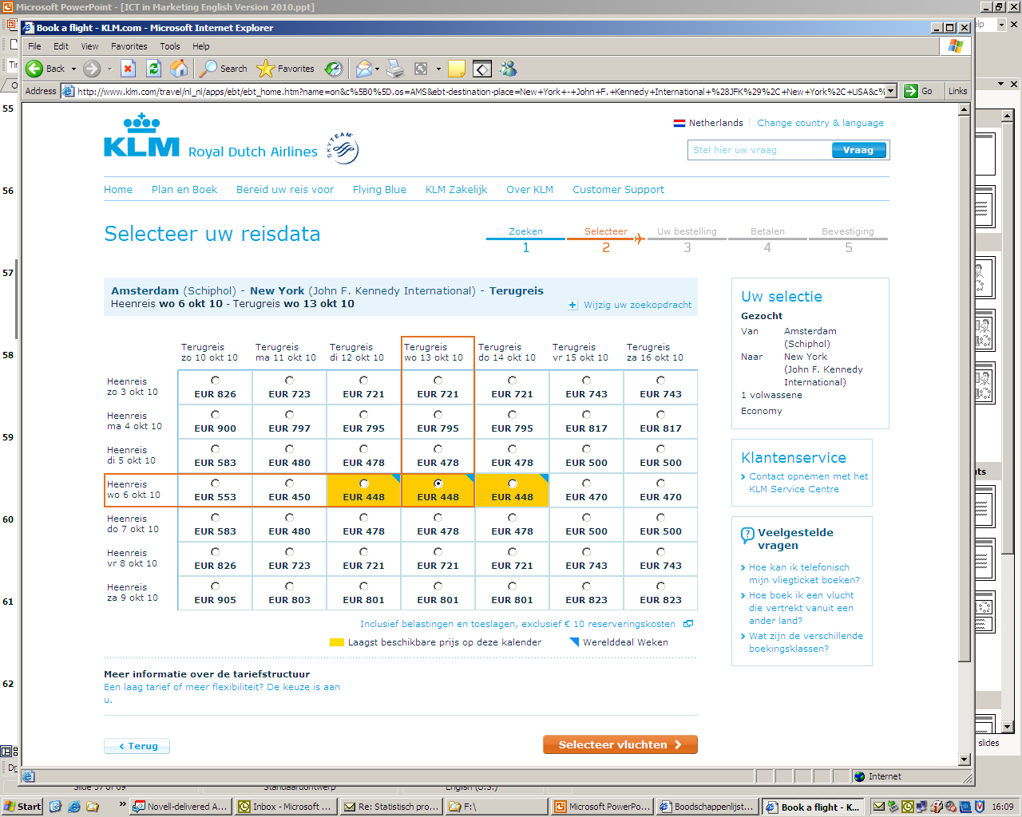

Slide 133
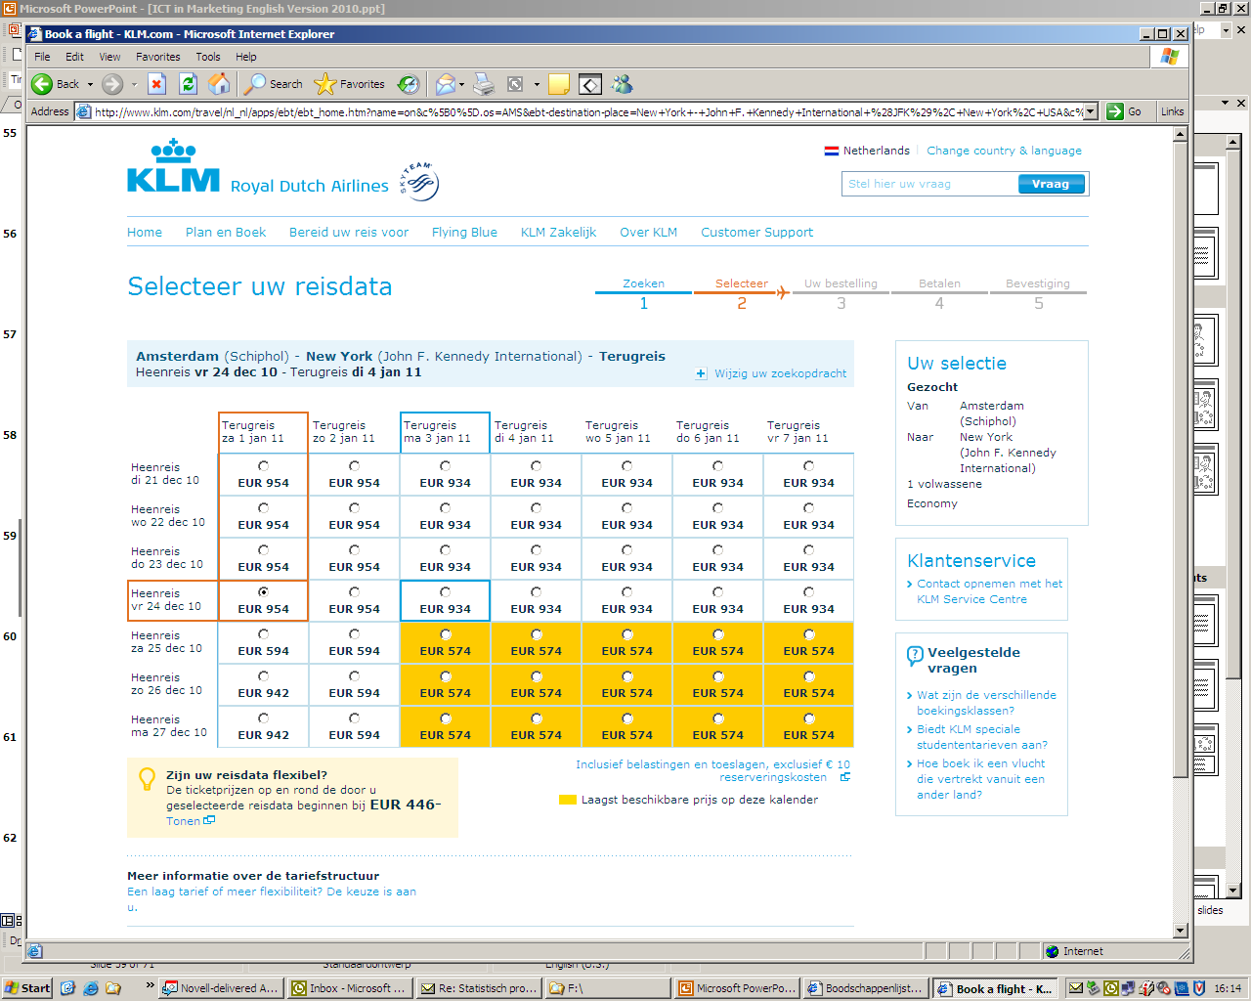

Slide 134
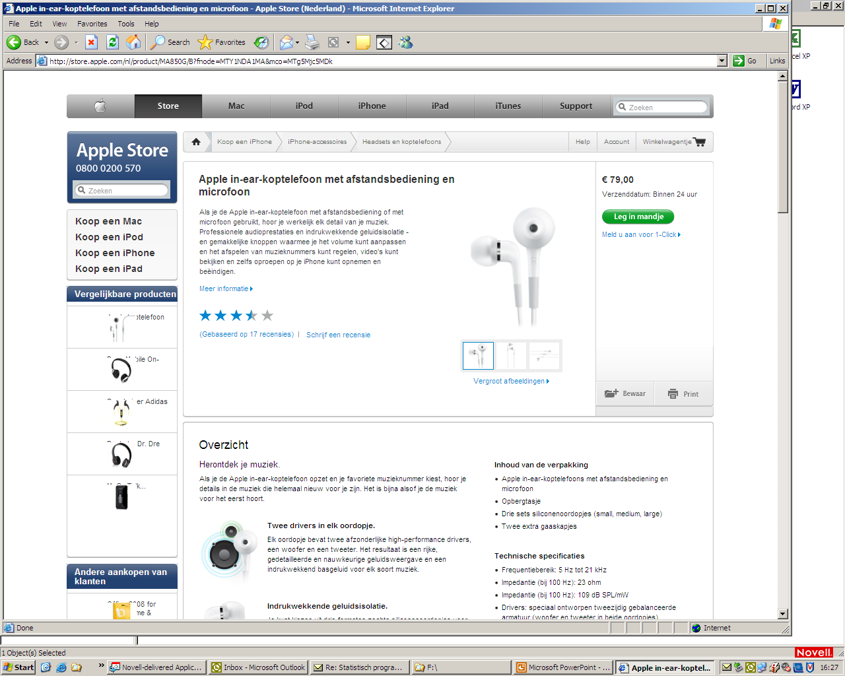

Slide 135
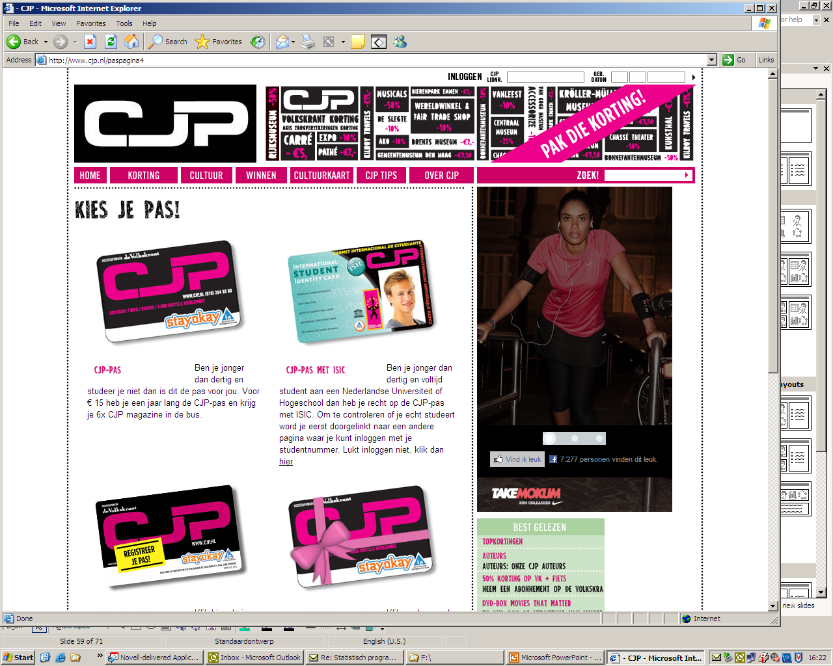

Slide 136
Competitor based
Positioning (differentiation)
Price Leader
Follower leader
(PUT OUT PRICING)
(STAY OUT PRICING)

Slide 137
Organization based
Profit based
Cost price +
Product line

Slide 138
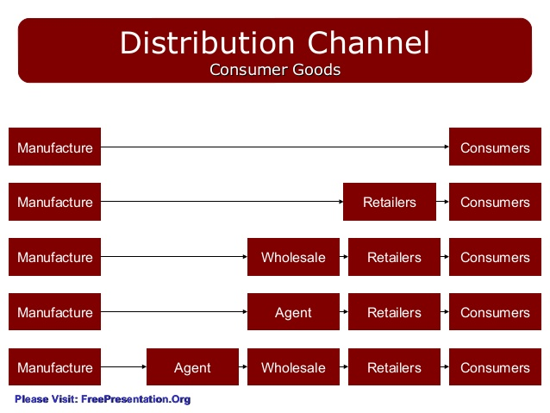
Place (distribution)

Slide 139
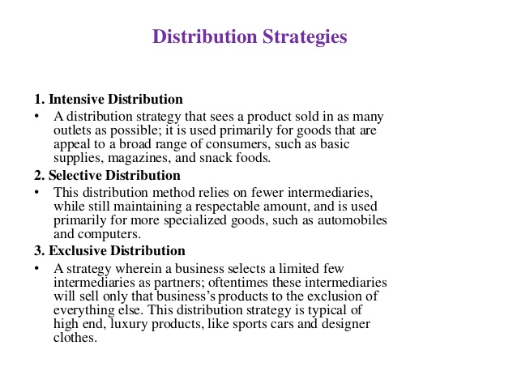

Slide 140
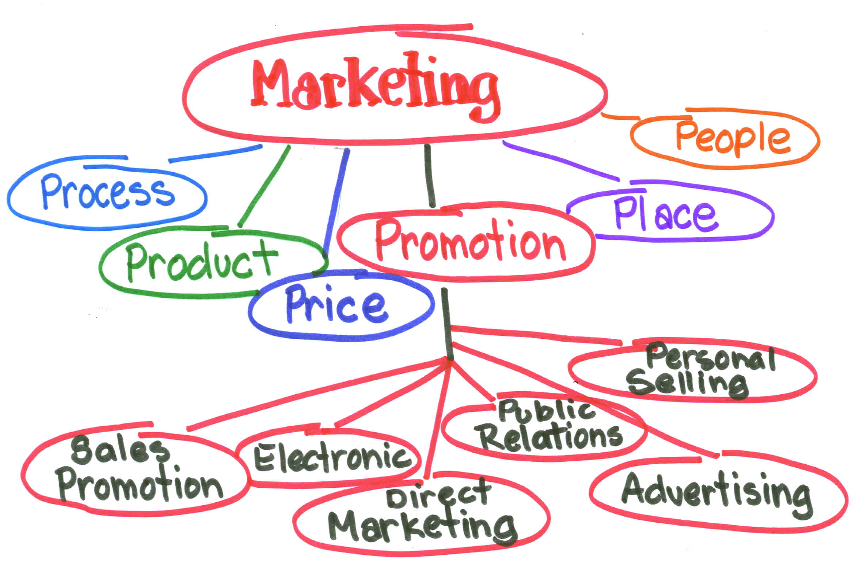
Promotion

Slide 141
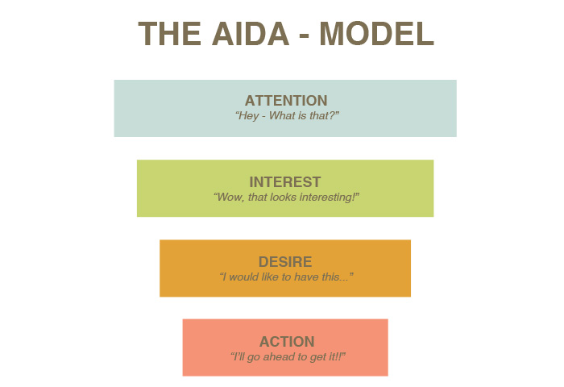

Slide 142
One more thing ….
WHEEL OF RETAILING

Slide 143
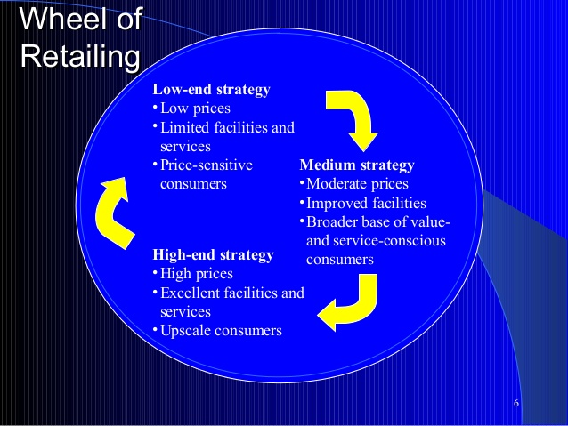

Slide 144
Week 13
Presentations

Slide 145
11 | Individual presentations websites Marketing segementation | Presentation analysis website (individual)
12 | Individual presentations website Marketing instruments | Presentation analysis website (individual) Presentation chapter 5 (team)
13 | Group presentation chapter 5 Individual presentations | Presentation chapter 7 and 8 (team) Presentation analysis website (individual)
14 | Group presentation chapter 7 and 8 Individual presentations
15 | Wrap up
16 - 19 | Write paper
20 | Deliver paper

Slide 146
Week 14
Presentations

Slide 147
11 | Individual presentations websites Marketing segementation | Presentation analysis website (individual)
12 | Individual presentations website Marketing instruments | Presentation analysis website (individual) Presentation chapter 5 (team)
13 | Group presentation chapter 5 Individual presentations | Presentation chapter 7 and 8 (team) Presentation analysis website (individual)
14 | Group presentation chapter 7 and 8 Individual presentations
15 | Wrap up
16 - 19 | Write paper
20 | Deliver paper

